Slide 1
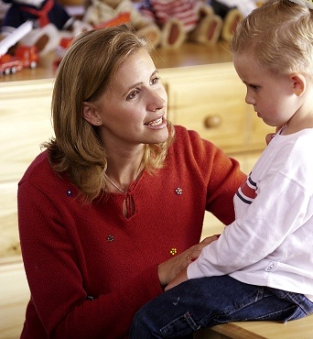
Lesson 7: Communication Styles
“I know you believe you understand what you think I said; but, I am not sure you realize what you heard is not what I meant.”
-Mother

Slide 2
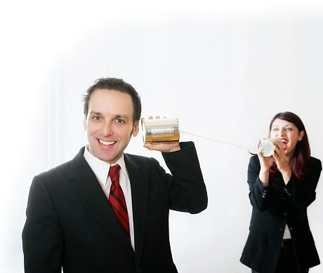
What is effective communication?
Communication: Any connection between humans
Both “verbal” & “non-verbal.”
You cannot “not” communicate.
We are ALWAYS communicating.

Slide 3
What are the basic levels of communication?
First level: Cliché Conversation.
A casual exchange of information.
Informal talk.
Second level: Fact Finding.
A simple exchange of information.
Third level: Feelings and emotions.
Sharing perceptions, feelings, judgments and beliefs about things.
Fourth level: Peak Communication.
Absolute openness and honesty are approached.
Fifth - To engage in the highest level of communication, trust and self-disclosure are critical.

Slide 4
What are the basic levels of communication?
There are risks and returns that come from entering deep relationships. Self-disclosure benefits include:
Keener awareness of self and improved ability to deal with problems.
Improves your communication and effectiveness.
Develop closer and meaningful relationships.
Become a healthier person.

Slide 5
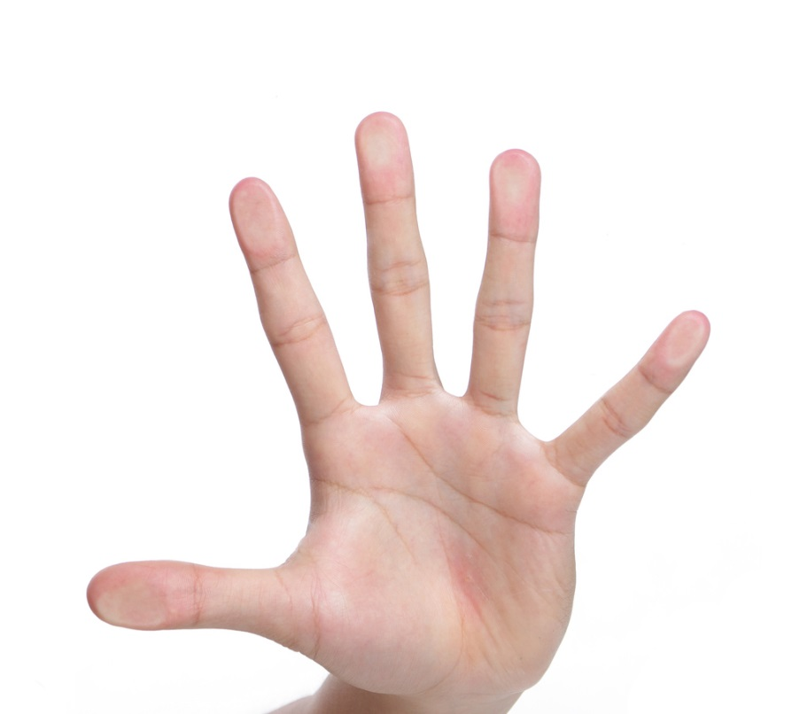
What are the 5 C’s of communication?
Clear
Goal or purpose
Easy to understand the meaning
Courteous
Friendly, open, honest
Concise
Stick to point
Avoid “filler words”
Complete
Has everything the audience needs to be informed
Correct
Fits your audience
Error free

Slide 6
What is non-verbal communication?
Non-verbal communication comes in many forms & fashions.
75% - 90% of communication is non-verbal-messages without words.
Used to both validate and refute verbal communication.
Be aware of the way you “look” and “present” yourself. The nature of your physical appearance says how you want to be perceived.
Facial expressions is a key non-verbal medium.
Cultural vs. universal expressions

Slide 7
What is non-verbal communication?
Eye Contact - We rarely use eye contact for extended periods of time.
This can be a sign of attraction or hatred.
Women make more eye contact than men.
Listeners make more eye contact than speakers.
Different cultures use eye contact differently.

Slide 8
What is non-verbal communication?
Body language is known as a kinesthetic code:
Notice gestures and acknowledge them, then ASK what the meaning is.
Slumped posture = low spirits.
Good, strong posture = high spirits.
Leaning forward = interest.
Leaning away = disinterested.
Crossed arms = sometimes may depict defensiveness.
Uncrossed arms = sometimes may be a willingness to listen.
There are thousands of body language cues.

Slide 9
What is non-verbal communication?
As a leader, your goal is to seek out and pay attention to non-verbal signals and learn their meanings.
Proximity (another non-verbal device):
0-18 inches = intimate.
18” – 4’ = normal personal space.
4’ – 12’ = formal transactions.
More than 12 feet apart represents a public forum.
Summary: It is difficult to interpret multiple non-verbal cues.

Slide 10
What are the four styles of communication?
There are four basic types of communication:
Aggressive: “I win, you lose” (aims to invade, control, take advantage)
Passive: “You lose, and it’s not my fault” (speaker allows others to control with speaker’s consent).
Passive-Aggressive: “You lose, but I win—but you don’t know I win” (manipulate others by using direct and dishonest messages)
Assertive: “I win, you win” (expressing outwardly your thoughts, feelings beliefs and being open and direct)

Slide 11
What are “You Messages?”
As a leader you must learn the difference between “You Messages and “I Messages”
“You Messages” are at the heart of aggressive communication.
They seek to accuse, control and attack others.
Example: “Why did YOU fall behind on that report?”

Slide 12
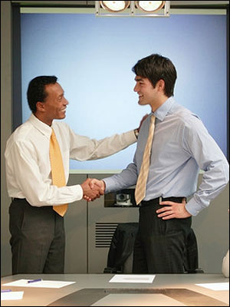
What are the five parts of an effective “I Message?”
You must change your communication into the “I Message” format. (5 Steps)
Explain how you feel. “I feel ...” (about your behavior)
Explain what you feel, “When you ...” (do a particular thing)
Explain your “Because ...” (reasons behind your thoughts and feelings)
Ask “How they feel ... ?”
Discuss how all of you can work together to solve the problem.

Slide 13
What is validation and how do we use it?
To validate someone: The act of confirming or corroborating the meaningfulness & relevance of that person.
Validating means to empathetically listen (truly understanding).
Practice active listening.
able to repeat back what is said.
Respond appropriately.
Use follow-up questions.
People may not remember what you said but they will remember how you made them feel.

Slide 14
What are additional communication tools and rules?
There are many communication rules and tools used to enhance relationships.
Avoid accusations.
Separate the person from the problem.
Stay away from absolutes. There are always shades of grey.
Don’t make personal evaluations of people.
Cater to an individual's “self-interest.”
Learn to set limits. They must understand what you can and cannot do for them.
Set clear consequences of their actions.
Use “and” instead of “but” in a conversation.

